Slide 1




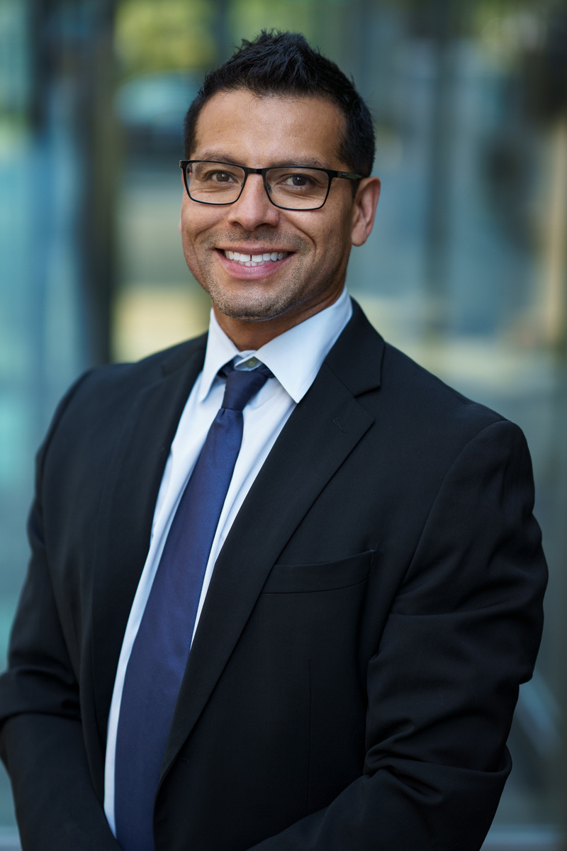
ONLINE
July 17th, 2023
BUSINESS
WEBINAR
Start at 7.00 pm
MARKETING AND SALES
efforts optimization in
the digital age
Keynote Speaker :
Bailey Dupont
Register Now
www.reallygreatsite.com

